Slide 1
PREDICTION OF CARDIOVASCULAR DISEASE USING MACHINE LEARNING ALGORITHM
PRESENTED BY,
B.ABINAYA
R.K.AKSHAYA PRIYA
P.CHANDRA LEKA
R.HARNI
GUIDED BY,
MR.P.ANAND,M.E.,
ASSISTANT PROFESSOR/IT

Slide 2
INDEX
Abstract
Objectives
Literature Survey
Module Description
Screenshots
Conclusion
Future Enhancements
References

Slide 3
ABSTRACT
Machine learning is an application of artificial intelligence that helps system to learn itself automatically and ability to improve experience without explicitly programmed. These days, machine learning plays a key role in many health-related problems, including the development of new medical procedures, the handling of patient data and records . According to 2019 estimation, Hypertension is a serious medical condition that significantly increases the risk of heart attack and stroke. The scope of the machine learning algorithms are increasing in predicting various disease .The nature of machine learning algorithm to think like a human being is making this concept so important and versatile. The main contribution of this project is to identify whether a patient has heart disease or not . It can predict heart disease using clinical data and test data from different patients using Random Forest Algorithm. RFA is the combination of many binary decision trees.

Slide 4
OBJECTIVES
Heart disease is the leading cause of death for both men and women and also Cardiovascular Disease (CVDs) are the number 1 cause of death globally
So the main objective of this project is to predict the cardiovascular disease using random forest Algorithm(RFA).

Slide 5
LITERATURE SURVEY
Title:
Heart Disease Diagnosis and Prediction Using Machine Learning And Data Mining techniques
Authors:
Animesh Hazra, Subrata Kumar Mandal, Amit Gupta, Arkomita Mukherjee and Asmita Mukherjee.
Description:
The aim of this paper is to summarize some of the current research on predicting heart diseases using data mining techniques, analyse the various combinations of mining algorithms used and conclude which technique(s) are effective and efficient. Also, some future directions on prediction systems have been addressed.
Advantages:
The accuracy of the proposed method for prediction is near to 80%.
Disadvantages:
It has been observed that a properly cleaned and pruned dataset provides much better accuracy than an unclean one with missing values

Slide 6
Title:
Medical Data Mining Method to Predict Risk Factors of Heart Attack and Raise Early Warning to Patients.
Authors:
M. Ilayaraja and Dr. T. Meyyappann
Description:
The healthcare domains have a lot of challenges and difficulties in diagnosing diseases.
Advantages:
The efficiency of level-wise generation of frequent item sets is improved which helps to reduce the search space.
Disadvantages:
Association rule mining requires the minimum support value and minimum confidence value.

Slide 7
Title:
Data Mining Approach to Detect Heart Diseases
Authors:
Vikas Chaurasia (Research Scholar, Sai Nath Universityy) ,Saurabh pal (Dept.of MCA,VBS Purvanchal Univercity)
Description:
The reduction of blood and oxygen supply to the heart leads to heart disease. However, there is a lack of effective analysis tools to discover hidden relationships and trends in data.
Advantages:
Naïve bayes classifiers are highly scalable, requiring a number of parameters linear in the number of variables in a learning problem.
Disadvantages:
Data scarcity chances of loss of accuracy. zero frequency that is if the category of any categorical variable is not seen in training data set then model assigns a zero probability to that category and then a prediction cannot be made.

Slide 8
Title:
Heart Disease Prediction Using Data Mining Classification.
Authors:
K.Gomathi1, Dr. Shanmugapriyaa
Description:
Investigated three data mining techniques: the Naïve Bayes, Artificial neural network, and the J48 decision tree algorithms. Our Analysis Shows that of these three classification models Naïve Bayes predicts heart disease with higher Accuracy.
Advantages:
In this paper they predict using three data mining techniques are compared in order to calculate accuracy.
Disadvantages:
This paper only designed to predict disease for males. They uses limited records to analyse.

Slide 9
Title:
Automated Diagnosis of Heart Disease using Data Mining Techniques
Authors:
Prof. Priya R. Patil and Prof. S. A. Kinariwala
Description:
The accurate diagnosis of a heart diseases, is one of the most important biomedical problems whose administration is imperative. In biomedical field, the classification of disease using data mining is the critical task. The prediction accuracy plays a vital role in disease data set.
Advantages:
It doesn't include any tuning parameters.
Disadvantages:
Ensemble based classification research has two main criticism- the dearth of publicly available real data to perform the experiments on and published well researched methods and techniques.

Slide 10
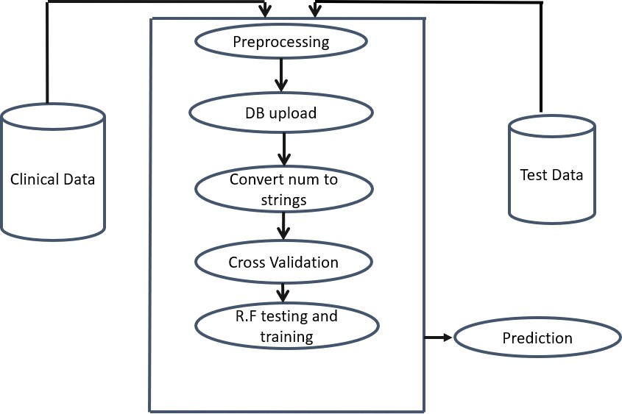
SYSTEM ARCHITECTURE

Slide 11
MODULE DESCRIPTION
Preprocessing
Cross Validation
Random Forest Testing & Trainings
Prediction

Slide 12
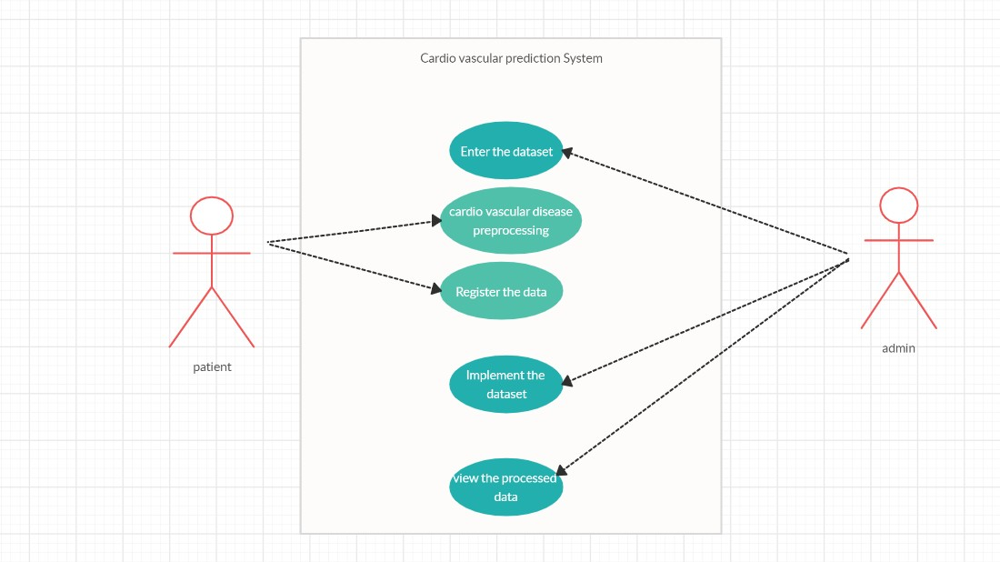
PREPROCESSING

Slide 13
DESCRIPTION
The UCI Machine Learning Repository is a collection of databases, domain theories, and data generators that are used by the machine learning community for the empirical analysis of machine learning algorithms.
In preprocessing, filtering technique is used.

Slide 14
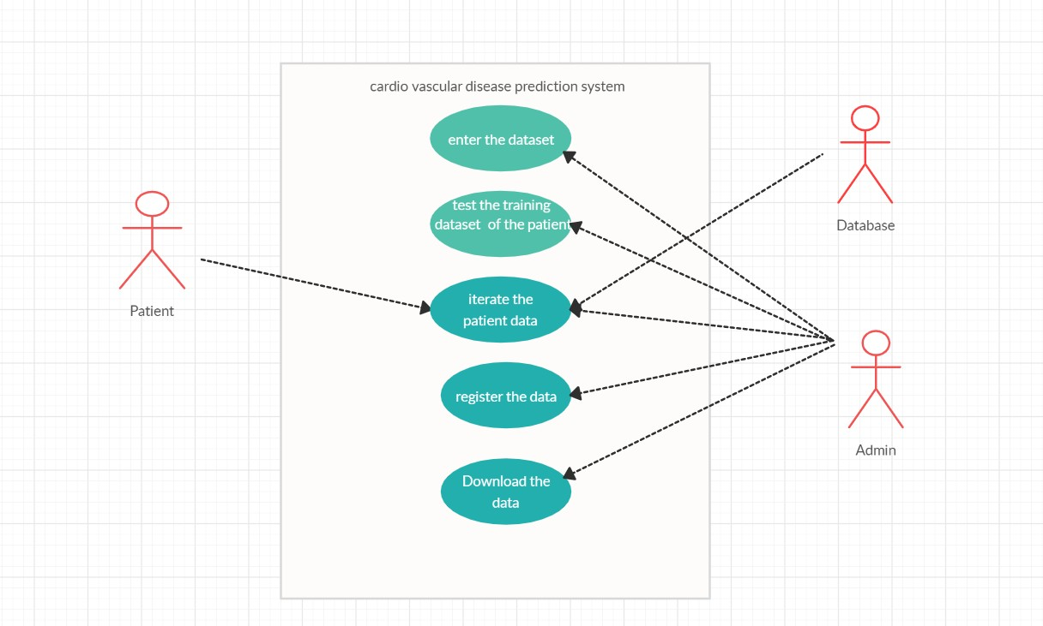
CROSS VALIDATION

Slide 15
DESCRIPTION
In order to achieve a reliable result from the Random Forests, cross-validation was used.
Cross validation divides the data set into a specific number of subsets.
Each subset is used by repeating both as a training record and as a test record.
The error estimates of all rounds are then summarized and averaged.

Slide 16
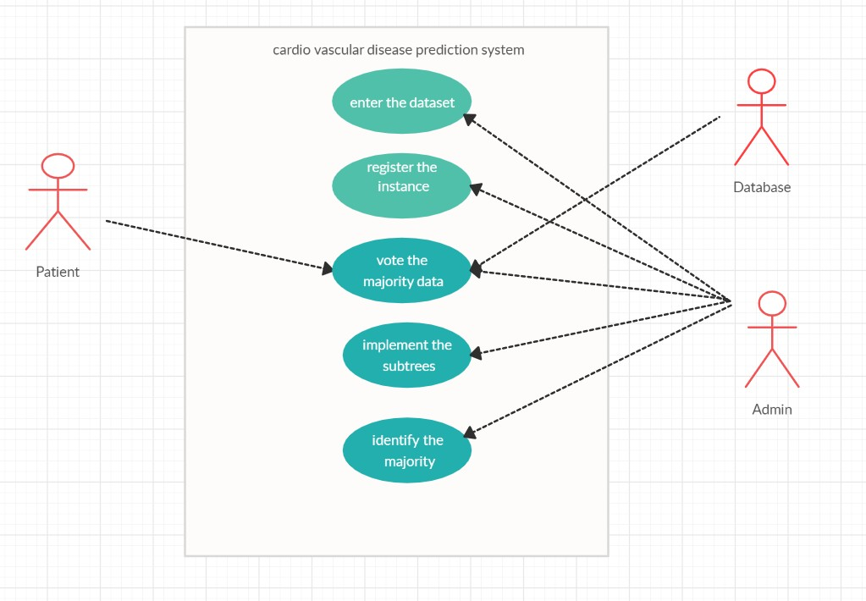
RANDOM FOREST TESTING & TRAINING

Slide 17
DESCRIPTION
The random forest is classification algorithm consisting of many decisions trees.
It uses bagging and feature randomness when building each individual tree to try to create an uncorrelated forest of trees whose prediction by committee is more accurate than that of any individual tree.
Random forests is great with high dimensional data since we are working with subsets of data.
It is faster to train than decision trees because we are working only on a subset of features in this model, so we can easily work with hundreds of features.

Slide 18
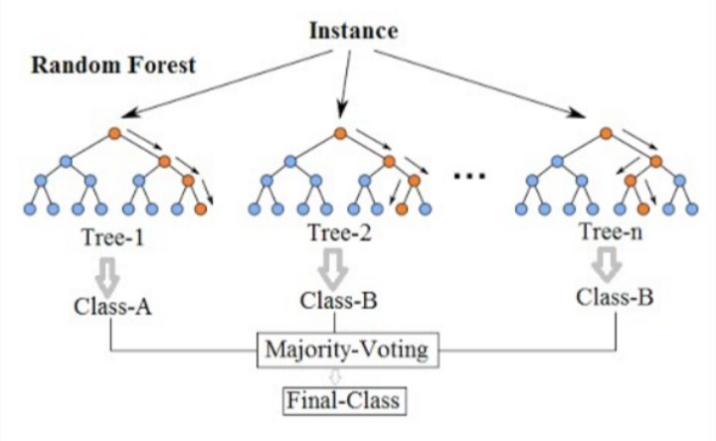

Slide 19
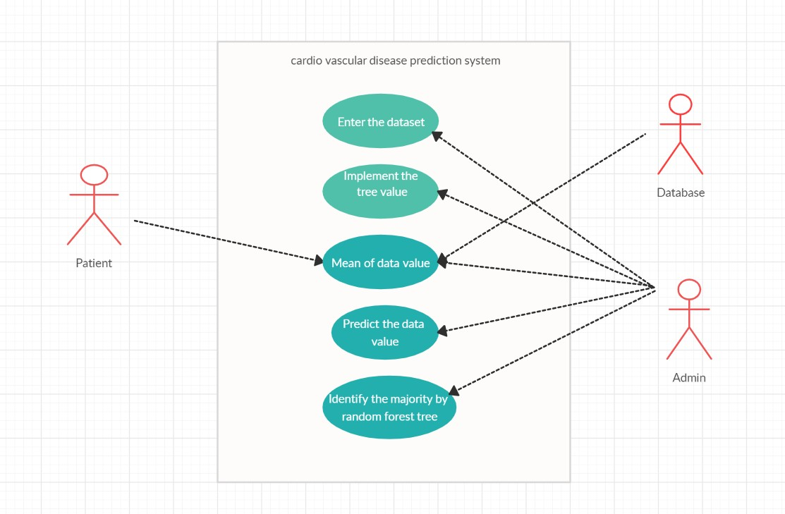
PREDICTION

Slide 20
DESCRIPTION
The improved prediction performance is a well-known in-built feature of ensemble methodology.
This study proposes a weighted vote-based classifier ensemble technique, overcoming the limitations of conventional DM techniques by employing the ensemble of two heterogeneous classifiers: random forest and classification via decision tree.

Slide 21
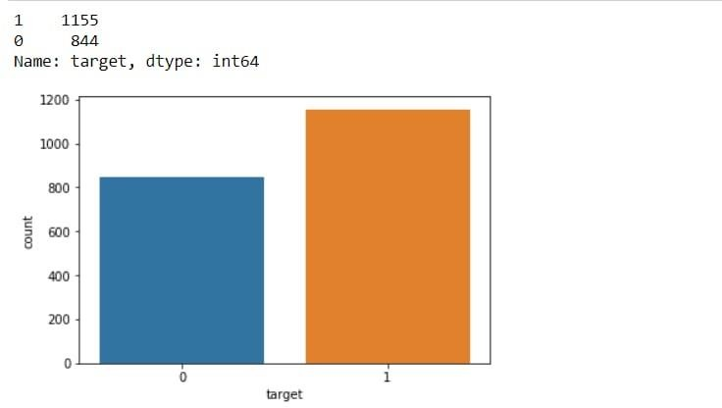
SCREENSHOTS

Slide 22
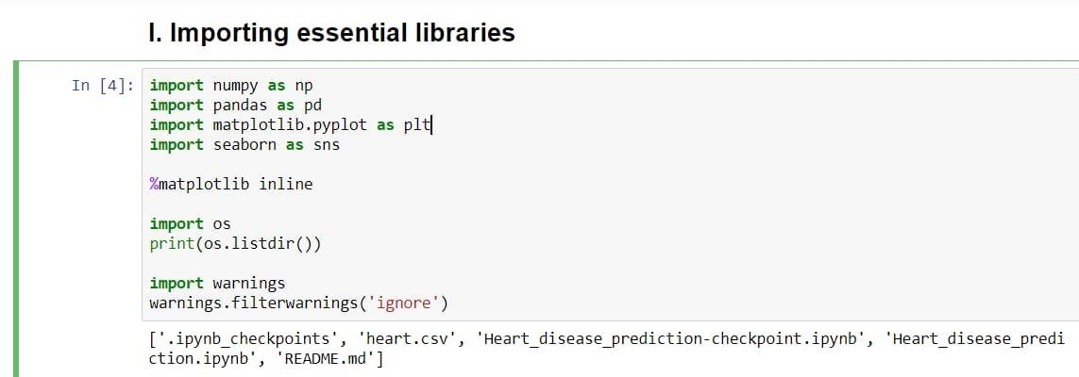

Slide 23
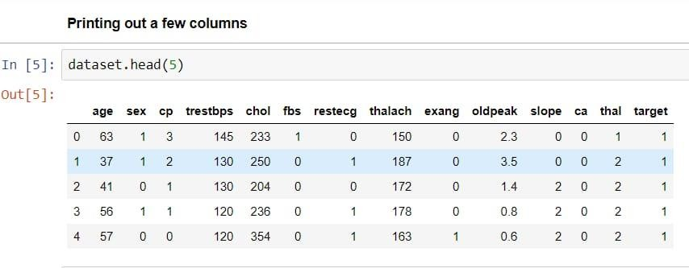

Slide 24
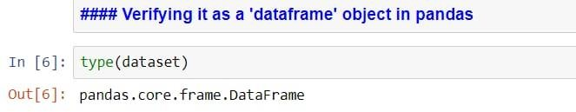
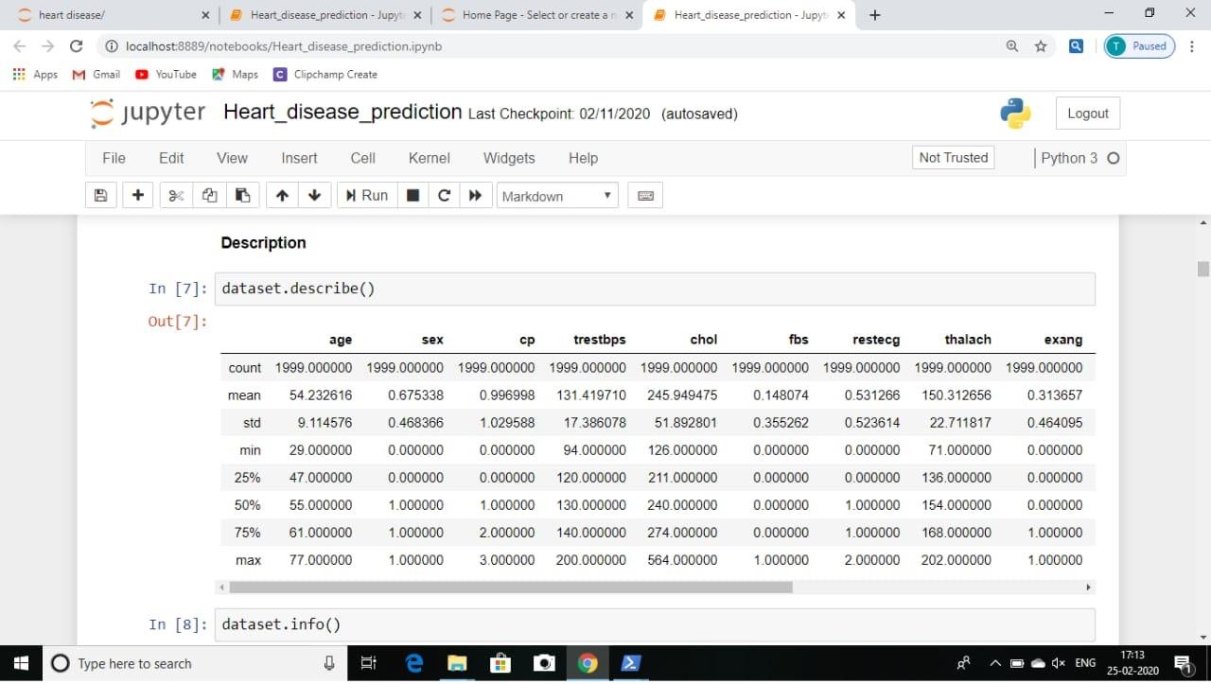

Slide 25
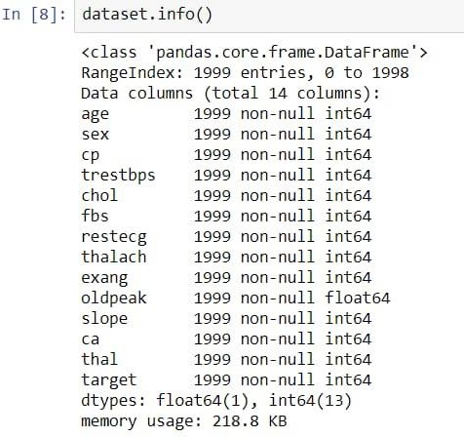
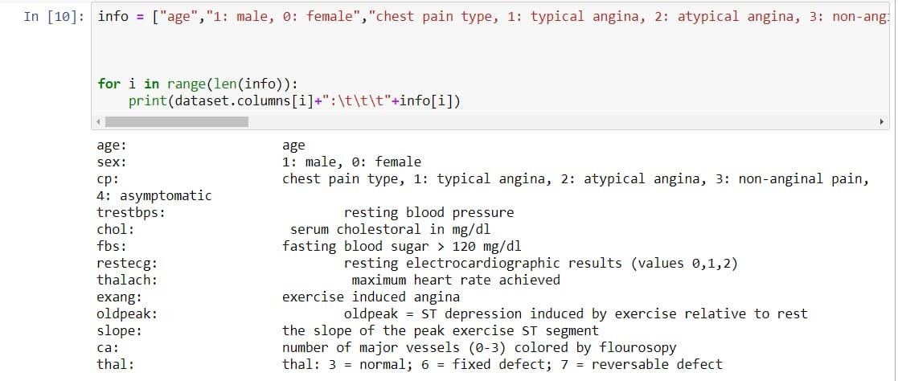

Slide 26
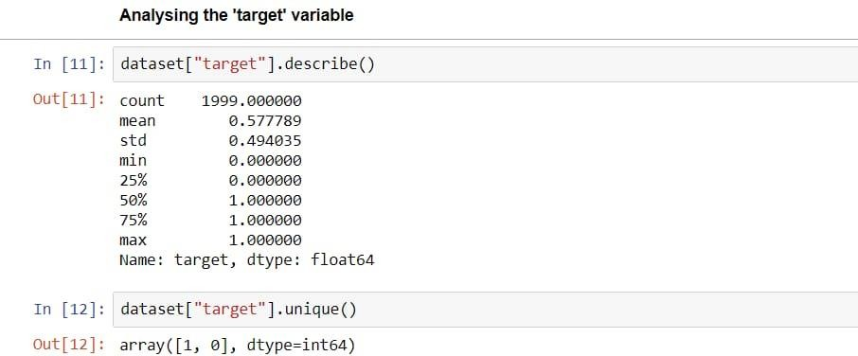
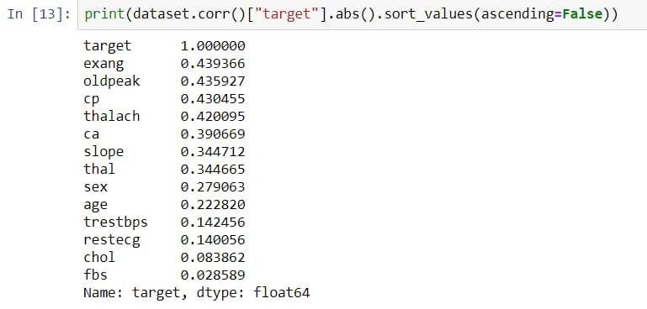

Slide 27
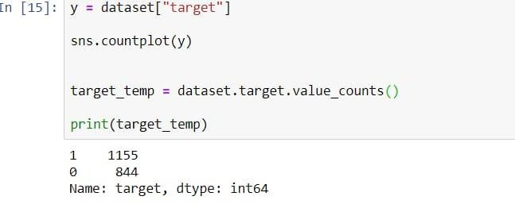
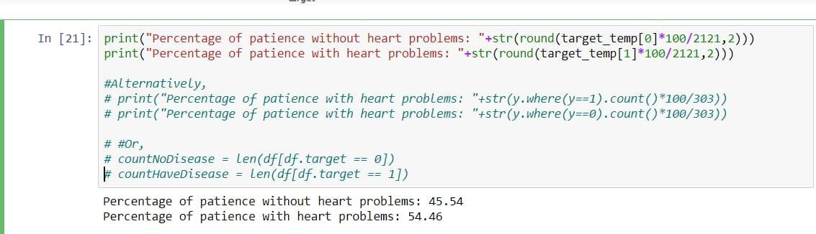

Slide 28
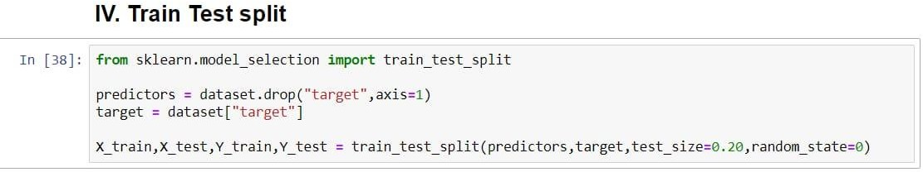
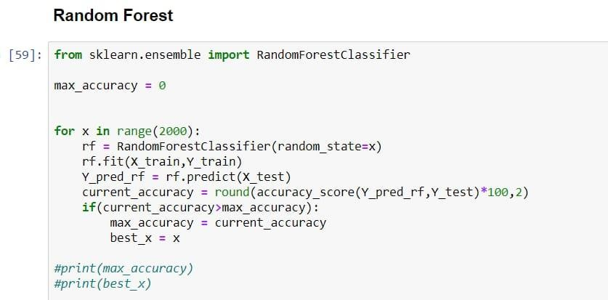

Slide 29
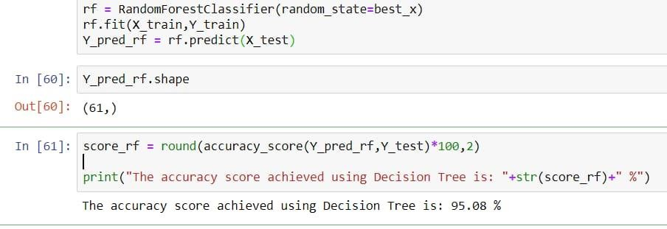
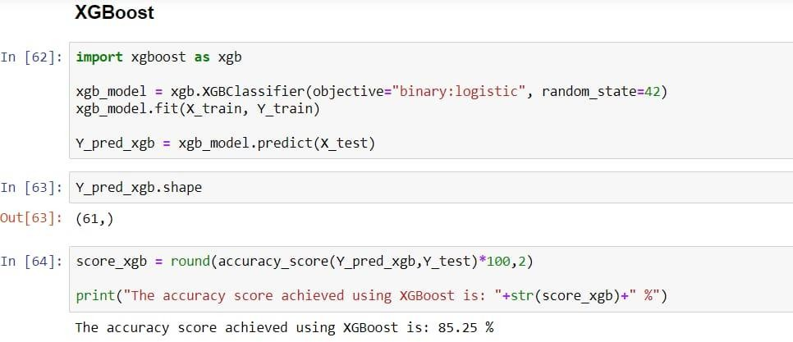

Slide 30
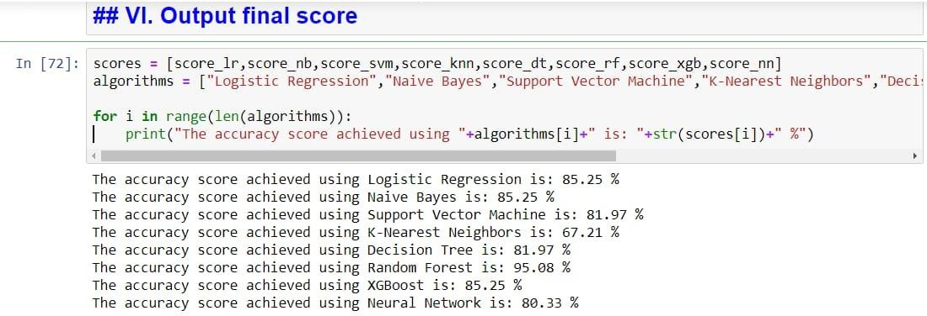

Slide 31
CONCLUSION
This paper presented a new approach to heart disease classification, using the Random Forest machine learning algorithm and attributes based on clinical data and patient test results. It reached an overall accuracy of 84.448%. The highest accuracy was reached while using an additional 10 times cross-validation in the process and it outperforms other machine learning techniques using the same database. Using the Random Forests algorithm without the cross validation secured an overall accuracy of 95%.

Slide 32
FUTURE ENHANCEMENTS
We will triangulate simple ECG sensor data with other physiological sensor data (i.e., heart rate variability, electroencephalography electrodermal activity , eye fixation , eye pupil diameter). Furthermore, we will experimentally evaluate whether our novel approach is also robust under various conditions of a user's cognitive workload , concentration , and mindfulness . In addition, we will report common method bias evaluations and the results of transferring our novel spectral method to ECG, where we already achieved outstanding results in predicting diseases such as schizophrenia , epilepsy , and sleep disorder based on electroencephalographic data. Finally, we will conduct an empirical implementation study to evaluate acceptance and trust by physicians and patients and if the automated approach improves the coordination between physicians more efficiently.

Slide 33
REFERENCES
Animesh Hazra, Subrata Kumar Mandal, Amit Gupta, Arkomita Mukherjee, Asmita Mukherjee, "Heart Disease Diagnosis and Prediction using Machine Learning sand Data Mining Techniques",2017.
M.Ilayaraja ,T.Meyyappann."Medical Data Mining Method to Predict Risk Factor of Heart Attack and Raise Early Warning to Patient",2015.
Vikas Chaurasia,Saurabh Pal,"Data Mining Approach to Detect Heart Diseases",2013.
K.Gomathi,Dr.Shanmugapriya,"Heart Disease Prediction Using Data Mining Classification",2013.
Priya R.Patil,S.A.Kinariwala,"Automated Diagnosis of Heart Disease using Data Mining Techniques",2017.

Slide 34

THANK YOU

